Slide 1

Materials Management

Slide 2

Material management
Material management involves organizing, and coordinating all management functions that are responsible for every aspect of materials, storage, and transformation
Bailey and Farmer define Material Management as the management of the flow of materials in to an organization to the point where those materials are converted in to the firm ‘s end products

Slide 3
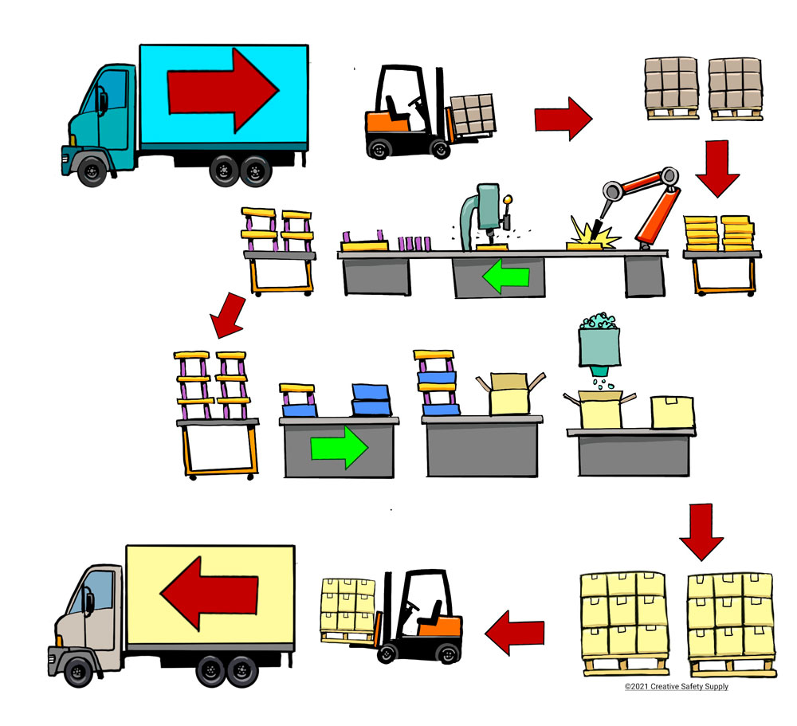

Slide 4

Materials Management
Meaning
The need for materials management was first felt in manufacturing undertakings.
The servicing organizations also started feeling the need for this control.
And now even non-trading organizations like hospitals, universities etc. have realized the importance of materials management.
Every organization uses a number of materials.
It is necessary that these materials are properly purchased, stored and used.

Slide 5


Any avoidable amount spent on materials or any loss due to wastage of materials increases the cost of production.
The object of materials management is to attack materials cost on all fronts and to optimize the overall end results.
Materials management connotes controlling the kind, amount, location and turning of the various commodities used in and produced by the industrial enterprises.
It is the control of materials in such a manner that it ensures maximum return on working capital.

Slide 6
DEFINITION
L.J. De Rose:
“Material management is the planning, directing, controlling and co-ordination of all those activities concerned with material and inventory requirements, from the point of their inception to their introduction into manufacturing process.”
N.K. Nair:
“Material management is the integrated functioning of the various sections of an organization dealing with the supply of materials and allied activities in order to achieve maximum co-ordination.”

Slide 7
Importance of Material Management
Material management is a service function. It is as important as manufacturing, engineering and finance. The supply of proper quality of materials is essential for manufacturing standard products. The avoidance of material wastage helps in controlling cost of production. Material management is essential for every type of concern.
1. The material cost content of total cost is kept at a reasonable level. Scientific purchasing helps in acquiring materials at reasonable prices. Proper storing of materials also helps in reducing their wastages. These factors help in controlling cost content of products.
2. The cost of indirect materials is kept under check. Sometimes cost of indirect materials also increases total cost of production because there is no proper control over such materials.

Slide 8
3. The equipment is properly utilized because there are no break downs due to late supply of materials.
4. The loss of direct labour is avoided.
5. The wastages of materials at the stage of storage as well as their movement is kept under control.
6. The supply of materials is prompt and late delivery instances are only few.
7. The investments on materials are kept under control as under and over stocking is avoided.
8. Congestion in the stores and at different stages of manufacturing is avoided.

Slide 9

Functions of Material Management
Material management covers all aspects of material costs, supply and utilization. The functional areas involved in material management usually include purchasing, production control, shipping, receiving and stores.
1. Production and Material Control:
Production manager prepares schedules of production to be carried in future. The requirements of parts and materials are determined as per production schedules.
Production schedules are prepared on the basis of orders received or anticipated demand for goods. It is ensured that every type or part of material is made available so that production is carried on smoothly.

Slide 10

2. Purchasing:
Purchasing department is authorized to make buying arrangements on the basis of requisitions issued by other departments. This department keeps contracts with suppliers and collects quotations etc. at regular intervals. The effort by this department is to purchase proper quality goods at reasonable prices.
Purchasing is a managerial activity that goes beyond the simple act of buying and includes the planning and policy activities covering a wide range of related and complementary activities.
3. Non-Production Stores:
Non-production materials like office supplies, perishable tools and maintenance, repair and operating supplies are maintained as per the needs of the business. These stores may not be required daily but their availability in stores is essential. The non-availability of such stores may lead to stoppage of work.

Slide 11


4. Transportation:
The transporting of materials from suppliers is an important function of materials management. The traffic department is responsible for arranging transportation service. The vehicles may be purchased for the business or these may be chartered from outside. It all depends upon the quantity and frequency of buying materials. The purpose is to arrange cheap and quick transport facilities for incoming materials.
5. Materials Handling:
It is concerned with the movement of materials within a manufacturing establishment and the cost of handling materials is kept under control. It is also seen that there are no wastages or losses of materials during their movement. Special equipment’s may be acquired for material handling.
6. Receiving:
The receiving department is responsible for the unloading of materials, counting the units, determining their quality and sending them to stores etc. The purchasing department is also informed about the receipt of various materials.

Slide 12
Why Materials Management
Materials is one of the five M’s of an industrial organization
Increasing Material costs
Materials offer considerable scope for improving profit.
Materials form an important form of current assets in any organization.
Material add value to the product
Suppliers and materials management account for more than 50 percent of total value.
Quality of the finished product depends on quality of materials used.
Social responsibility of business.
Exploring new sources of supply is a challenge for material management.

Slide 13
Objectives of Material Management
Buying, storage, and movement of material are the three basic objectives of materials management.
Optimum investment in inventory is the prime objective of materials management.
Primary Objectives
      Lower prices
      High Inventory Turnover
      Low cost acquisition and possession
      Continuity of supply
      Consistency of quality
      Favorable supplier relations
Secondary Objectives
Reciprocal Relations
New materials and products
Economic make or buy
Standardization
Product Improvement
Inter departmental harmony
Forecasts
Acquisitions

Slide 14
Purchasing
Purchasing is the act of buying an item at a price
Purchasing is responsible for obtaining the materials , parts , supplies and services needed to produce a product or provide a service.
Objectives
Purchasing objective: Buying raw materials of the right quantities, in the right-quality at the right time, at the right price, and from the right source.
      To pay reasonably low prices for best values obtainable.
      To keep inventories as low as possible
      Collaborative relationship with supplies
      To secure good vendor performance – delivery and quality
      To locate new materials or products as required
      To develop good procedure together with adequate control and purchasing policies
      To implement programs like value analysis, cost analysis and make or buy decision.

Slide 15
Purchasing Functions
Responsibilities often fully delegated to the purchasing function
      Obtaining prices
      Selecting vendors
      Awarding purchase orders
      Following up on delivery promises
      Selecting and training of purchasing personnel
      Vendor relations
Functions other than purchasing functions
      Obtaining Technical information and advice
      Scheduling orders and delivers
      Inspecting
      Accounting
      Expediting
      Determination of whether to make or buy
Other functions
      Receiving and warehousing
      Payment of invoices

Slide 16
Purchasing Cycle
Purchasing cycle comprising of eight steps.
      Recognition of Need
      Description of Requirement
      Selection of Source
      Determination of Price and Availability
      Placing the Order
      Order Acknowledgement
      Follow Up and Expediting
      Checking The Invoice and Approval

Slide 17
Factors in source/vendor selection
Reliability Technical Abilities
After sales service availability
Past experience Price
Quality
Discounts received Promptness of delivery Co-operation
Credit terms Installation costs Financial Position

Slide 18
Vendor rating
– The ability to select reliable vendors is a successful purchasing action
Rating Techniques
Categorical Plan
The weighted Point Plan
Critical Incidents Method
Checklist System
    Reliability
    Technical capabilities
    After- sale service
    Availability
    Buying Convenience
    Sales assistance

Slide 19
Ethics in Purchasing
Ethics is segment of philosophy concerned with values of human conduct.
the term ethics refers to a code of conduct that guides an individual in dealing with others.
Ways to achieving Ethical Behaviour
  Definite polices on all matters involving ethics should be formulated
  An attempt should be made to create a working environment,where unethical temptations seldom become realities

Slide 20
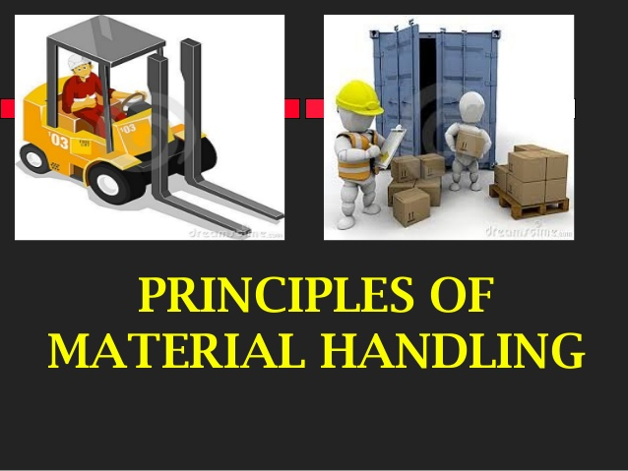

Slide 21
Meaning of Material Handling:
Material handling may be considered a specialized activity for modern manufacturing units.
From the time, the input material or raw materials enter the industrial unit and go out of the unit in the form of finished products, these are handled at all stages in between, no matter, on the shop floor or in the stores.
It has been estimated that the average material handling cost is roughly 30 to 60% of the cost of production.
This is so since majority of production time is consumed in handling materials before, during and after the manufacture.
However, this cost can be reduced by proper selection, operation, maintenance and layout of material handling devices but cannot be totally eliminated.

Slide 22
The material handling problem must be analyzed thoroughly at the time planning of various machines and tools needed before erection of factory building.
While designing new plants, materials handling is a prime consideration and several existing plants can be modified by the utilization of modem material handling devices.
The cost of production is decreased by the use of these devices since these devices increase output, improve the quality and speed up the deliveries.

Slide 23
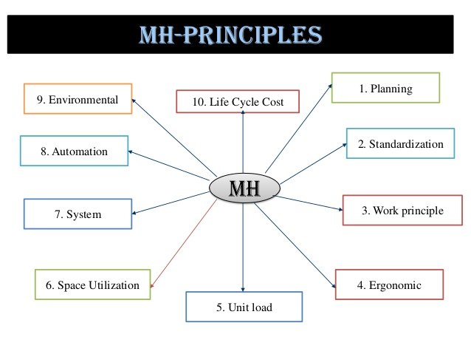

Slide 24
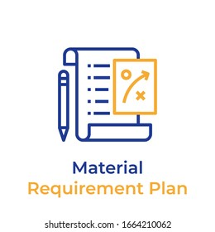
The Twenty Principles of Material Handling
Orientation Principle
Study the system relationships thoroughly prior to preliminary planning in order to identify existing methods and problems, physical and economic constraints, and to establish future requirements and goals.
2. Planning Principle
Establish a plan to include basic requirements, desirable options, and the consideration of contingencies for all material handling and storage activities.
3. Systems Principle
Integrate those handling and storage activities which are economically viable into a coordinated system of operation including receiving, inspection, storage, production, assembly, packaging, warehousing, shipping and transportation.

Slide 25
4. Unit Load Principle
Handle product in as large a unit load as practical.
5. Space Utilization Principle
Make effective utilization of all cubic space.
6. Standardization Principle
Standardize handling methods and equipment wherever possible.
7. Ergonomic Principle
Recognize human capabilities and limitations by designing material handling equipment and procedures for effective interaction with the people using the system.
8. Energy Principle
Include energy consumption of the material handling systems and material handling procedures when making comparisons or preparing economic justifications.

Slide 26
9. Ecology Principle
Minimize adverse effects on the environment when selecting material handling equipment and procedures.
10. Mechanization Principle
Mechanize the handling process where feasible to increase efficiency and economy in the handling of materials.
11. Flexibility Principle
Use methods and equipment which can perform a variety of tasks under a variety of operating conditions.
12. Simplification Principle
Simplify handling by eliminating, reducing, or combining unnecessary movements and/or equipment.
13. Gravity Principle
Utilize gravity to move material wherever possible, while respecting limitations concerning safety, product damage and loss.

Slide 27
14. Safety Principle
Provide safe material handling equipment and methods which follow existing safety codes and regulations in addition to accrued experience.
15. Computerization Principle
Consider computerization in material handling and storage systems, when circumstances warrant, for improved material and information control.
16. System Flow Principle
Integrate data flow with the physical material flow in handling and storage.
17. Layout Principle
Prepare an operational sequence and equipment layout for all viable system solutions, then select the alternative system which best integrates efficiency and effectiveness.

Slide 28
18. Cost Principle
Compare the economic justification of alternate solutions in equipment and methods on the basis of economic effectiveness as measured by expense per unit handled.
19. Maintenance Principle
Prepare a plan for preventive maintenance and scheduled repairs on all material handling equipment.
20. Obsolescence Principle
Prepare a long range and economically sound policy for replacement of obsolete equipment and methods with special consideration to after-tax life cycle costs.

Slide 29


